Slide 1
Movie rental
Mohamed Sameh
Alaa Nosser
Abudllah Samir
Milad George
Ismail Mohamed

Slide 2
Description
Movie rental allows people to rent movies through online payments
Within a good collection of movies and the ability to add more
It works only for a specified time set based on owner’s choice

Slide 3
Tasks
Mohamed Sameh: Home (Modify) + Movie description+ rent + Sign in +JS
Alaa Nosseir: Home (Full) + Footer + JS+ Movie description
Abudllah Samir: About us
Milad Georges: Sign up + Movies
Ismail Mohamed: JS+ rent

Slide 4
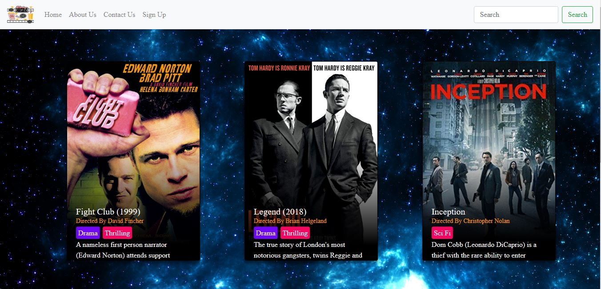

Slide 5
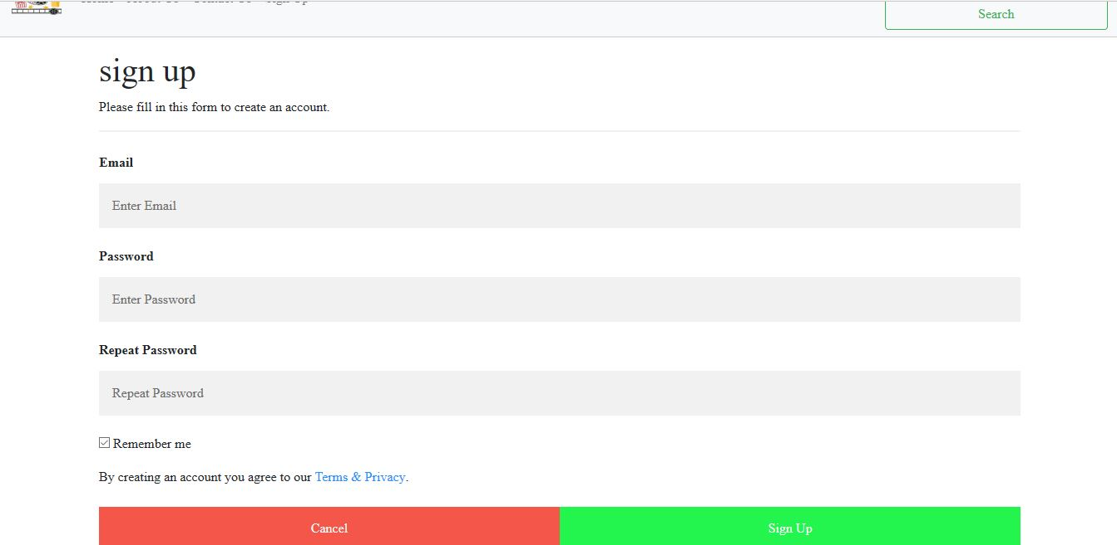

Slide 6


Slide 7


Slide 8
